Slide 1
Rumen-protected fats for dairy cows
Dr Richard Kirkland
7th February 2013
Agrofarm, Moscow

Slide 2
Role of fat in rations
Essential component of any ration
Primarily an energy source
Increase energy density of diets
Highest efficiency of conversion of ME to NE
Increase milk production and herd fertility
Increase feed efficiency
Reduce environmental emissions (e.g. methane)

Slide 3
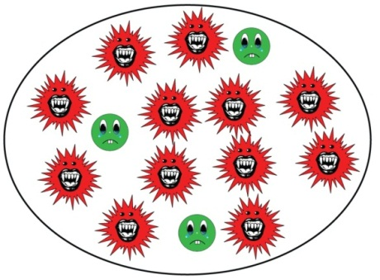
Role of fat in rations
Reduce acidosis - formulation of balanced rations
Acidotic rumen
Dietary fats
Ideal rumen
Starch bacteria
Fibre bacteria
Fatty acid profile is a key factor determining the nutritional value of a fat

Slide 4
Rumen-active oil
Fish oil, vegetable oil, high-oil ingredients
Kills rumen bacteria
Reduces fibre digestion
Produces trans fatty acids – milk fat depression

Slide 5
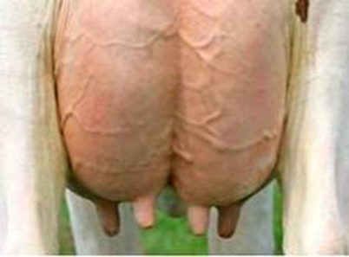
Dietary fat, trans fat, and milk fat depression
Unprotected fat
Specific rumen conditions e.g. low rumen pH
Fibre, feed system, starch
e.g. Linoleic acid
Biohydrogenation by rumen bacteria
Trans fatty acids
trans-10, cis-12 CLA
Milk fat depression

Slide 6
Rumen-protected fat supplements
Avoid negative effects on fibre digestion in the rumen
Avoid milk fat-reducing trans fats in rumen
Major groups of rumen-protected fats
Saturated fatty acids e.g. hydrogenated / fractionated
high melting point fats
Calcium salts of palm oil
Megalac
Most-highly proven

Slide 7
Energy sources for dairy cattle
Type | Example | ME (MJ/kg DM) | NE_{L} (MJ/kg DM)
Forage | Grass silage | 9-12 | 6.8
Digestible fibre | Sugar beet pulp | 12.5 | 8.3
Starch | Wheat / maize (corn) | 13-14 | 9.4
Megalac protected fat |  | 33.3 | 27.3
Fat has 2.5 to 3 times the energy concentration of cereals

Slide 8
Rumen-protected fat – filling the energy gap
Bodyweight
THE ‘ENERGY GAP’
Dry matter intake
Milk Yield
Months after Calving
Calving
Calving

Slide 9
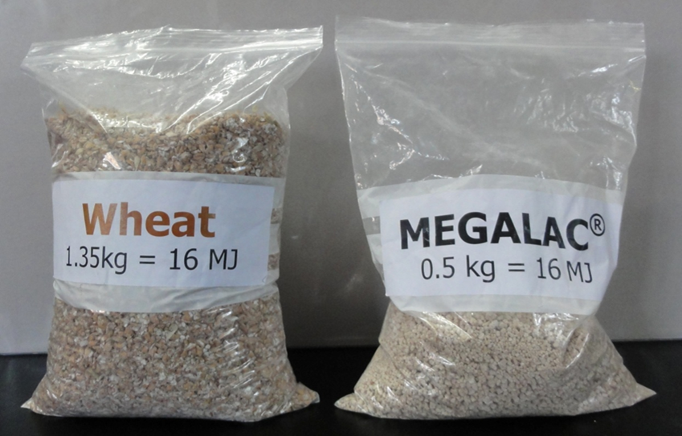
Megalac increases energy density
500 g Megalac increases energy density by
0.5 MJ/kg DM
= over 2 litres of milk
Less physical space taken up in rumen
Maintain/improve rumen health
More energy per bite

Slide 10
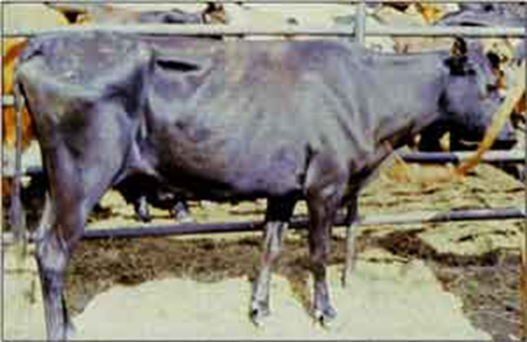
Fertility - energy supply is critical
Proven rumen-protected fats increase energy density and energy supply
Days to ovulation
Conception rate (%)
Condition score change in early lactation
From Garnsworthy (2007)
Butler (2004)

Slide 11
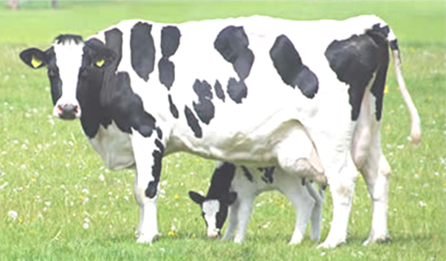
Megalac vs progesterone (3-5 days post ovulation)
Linear (P=0.036)
A high proportion (~25%) of cows are at risk from insufficient progesterone (Morris and Diskin, 2007)
Garnsworthy et al. (2008)

Slide 12
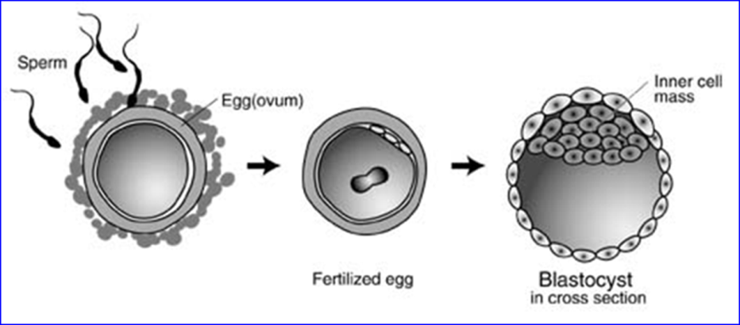
Megalac effects on egg quality
Cows offered low vs high fat diets - 1051 oocytes fertilised in vitro
Higher fat diets produce more viable oocytes
Fouladi-Nashta et al. (2007)

Slide 13
Balancing protected fat and protected protein
Fat is not an energy source for growth of rumen microbes
Maximum benefits achieved when balanced with rumen-protected protein
Recommendations for fat >3% in rations (Chalupa, 1990)
14.1 g undegraded protein per MJ ME from fat
Approx. 50 g undegraded protein per MJ fat

Slide 14
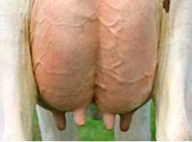
Rumen-protected fats in dairy rations - summary
Dairy cows have an essential need for fat
Only ‘safe’ way to deliver this is in rumen-protected form
fatty acid profile very important
Unique nutrient :
Increase energy density
Formulate more-balanced rations
Increase milk production and fertility

